Slide 1

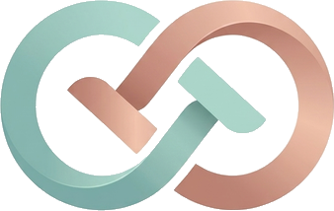
// team
BLACK DRAGON
presents
SheSync
AI-powered, privacy-first menstrual & hormonal health companion for Indian women
Theme: HealthTech / FemTech
Category: Software
team.ts — Black Dragon
1
2
3
4
5
6
7
8
const team = new Team("Black Dragon");
team.members = [
"Vyom Varshney",
"Vishal Gupta",
"Shivangi Yadav",
"Vanshika Singh",
];
team.build("SheSync"); // care, coded for her
Notes:
Team Black Dragon presents SheSync. Members: Vyom Varshney, Vishal Gupta, Shivangi Yadav, Vanshika Singh. Cover dragon silhouette adapted from game-icons.net (CC BY 3.0).

Slide 2






OBJECTIVE - To build SheSync — an AI-powered, privacy-first menstrual and hormonal health companion that turns a woman's cycle, pain, mood and sleep logs into personalised daily care (cycle predictions that work for irregular / PCOS cycles, adaptive workouts, mind support) and a doctor-ready 90-day report — designed for Indian women.
SOLUTION APPROACH
WORKFLOW DIAGRAM
SOLUTION PIPELINE
Phase 1: User Context Input
10-question clinical intake → personal health archetype
Past cycle dates, goals & conditions
Phase 2: Multi-Modal Daily Logging
Flow, pain (0–10 + location), mood & energy
Voice journal; sleep & HRV via Health Connect
Phase 3: The Intelligence Layer
Cycle Engine — recency-weighted forecast for irregular / PCOS cycles
Strain Engine — pain + sleep + mood → 0–100 body load
Advisory Generator — scores → plain-language actions
Phase 4: Personalised Care Output
Adaptive workouts & somatic relief sessions
Discreet reminders, CBT prompts & SOS
90-day Doctor Co-Pilot PDF report
SOLUTION APPROACH
USER ACCESS &
ONBOARDING
Sign-up / Login
Supabase Auth · email
Health Assessment
10 Qs → archetype
Past Cycles
Calendar baseline (1–4)
1
User Context Input
DAILY DATA
CAPTURE &
VALIDATION
Data sources (on-device + cloud sync)
Assessment · cycles · goals
Flow log
Pain log
Mood & energy
Voice journal
Health Connect
2
Multi-modal daily logs
Validation & normalisation
range checks · one log per day · offline queue
Flow · pain · mood · voice · sleep
AI ANALYSIS
PIPELINE
Cycle Prediction Engine
recency-weighted average + CV% → next period & ovulation window
3
Cycle Engine
3
Strain Engine
3
Advisory Generator
Strain & Phase Engine
pain + sleep + mood → 0–100 load; cycle phase; workout-override rules
AI Advisory Generator
turns scores into clear actions, CBT prompts & 'see a doctor' flags
Irregular-aware forecast
0–100 body-load score
Plain-language tips
PERSONALISED
OUTPUT &
ACTIONS
Phase-aware cards for PCOS, PMDD, high-pain, students & athletes
Home Dashboard
strain gauge · predictions · quick logs
Move & Mind
adaptive workout · somatic videos · SOS
Doctor Co-Pilot
90-day trends + PDF report
4
Personalised Care Output
Workouts · relief · reports
CONTINUOUS
LEARNING
LOOP
New logs
Re-calibrate baseline
Sharper predictions
More personal care
Technology
Stack
React Native
Expo
Zustand
Reanimated
Supabase
Edge Fns
PostgreSQL
AsyncStorage
LLM API
Python
EAS Build
EAS Update
TypeScript
NativeWind
RN SVG
Expo Print
Auth (JWT)
RLS
SQLite
pgvector
scikit-learn
NumPy
Play Store
Vercel
Frontend Framework
State & UI
Backend & Auth
Database Layer
AI / ML Integration
Deployment
Notes:
Objective, end-to-end solution pipeline, system workflow and tech stack. Walk left to right: what she inputs, how the engines process it, what she gets back, and how the loop keeps improving predictions.

Slide 3


































TECHNICAL APPROACH
MVP SCOPE
PERSONALISATION DIAGRAM
IMPLEMENTATION DIAGRAM
Onboarding: 10-question clinical intake → personal archetype
1
Phase 1:- Foundation & Data
Period
Flow
Pain
Mood
Energy
Sleep
HRV
Voice
Survey
Expo + React Native app shell
Supabase Auth & schema (RLS)
Assessment & logging screens
Smart Logging: one-tap flow, pain, mood & voice journal
PERSONALISATION ENGINE
Cycle understanding · AI/ML models · preference learning · real-time adaptation
2
Phase 2:- Cycle Care
Cycle prediction engine
12-month calendar & past cycles
Phase-aware insights
Cycle Prediction: irregular / PCOS-aware next period & ovulation window
1
PCOS / PCOD
2
PMDD & mood
3
Severe cramps
4
Heavy flow
Long-cycle forecasts
Insulin-friendly tips
Gentle strength plans
Late-luteal alerts
CBT reframing
Vagus breathing
Pain map & triggers
Heat / relief plans
Rest-day override
Flow & clot logs
Iron / hydration tips
'See a doctor' flags
3
Phase 3:- Intelligence Layer
Adaptive Care: workouts & somatic sessions that change with body strain
AI/ML: Variance-aware cycle model
AI/ML: Mood-phase risk score
AI/ML: Pain–strain index
AI/ML: Rule-based red flags
Strain & override engine
AI advisory via Edge Function
Health Connect (HRV, sleep)
5
Students
6
Fitness lovers
7
Working women
8
Doctor visits
Exam-week energy plan
Discreet reminders
Hostel-friendly tips
Phase-synced workouts
Recovery score
Safe intensity caps
Sleep-debt watch
Stress resets
Busy-day planning
90-day trends
Symptom timeline
Shareable PDF
4
Phase 4:- Care & Clinical Output
Mind Support: CBT prompts, vagus-nerve audio & SOS
Move & Mind modules
SOS + CBT support
Doctor Co-Pilot PDF
AI/ML: Phase energy forecast
AI/ML: Strain → override FSM
AI/ML: Sleep + stress fusion
AI/ML: Anomaly detection
5
Phase 5:- Pilot & Launch
Doctor Co-Pilot: 90-day trends + shareable PDF report
Period
forecast
Adaptive
workout
Pain relief
plan
Calm
session
CBT
reframe
Discreet
reminder
AI cycle
chat
Doctor
report
Campus pilot (100 users)
Feedback & re-calibration
Play Store launch
One cycle engine
Different bodies
Personalised care
Notes:
MVP scope (already built in React Native + Supabase), how the personalisation engine maps 9 body signals to 8 user needs, and the 5-phase build plan.

Slide 4





FLOWCHARTS
DATAFLOW DIAGRAM
USE CASE DIAGRAM
sign-up · assessment · goals
1
User Context & Profile
profile +
archetype
3 Intelligence & Personalisation Engine
Track Cycle
Log period start & end
See next period & ovulation window
User
Cycle Predictor
Strain Engine
Log Symptoms
Record pain, flow & mood in one tap
Add a private voice journal
read / write
Every woman
Data Sources
D1
User Profile &
Preferences
Override Rules
AI Advisory
Period & flow logs
PCOS / Irregular Care
Get variance-aware predictions
Follow PCOS lifestyle guidance
Pain & mood logs
D3
Health content
& video library
cycle history
Voice journal
Mood & Mind Support
Use CBT reframe & calming audio
Tap SOS for Tele-MANAS (14416)
2
Data Ingestion, Validation & Sync
PCOS / PMDD users
Health Connect / HealthKit
Assessment answers
Range checks
One log per day
Offline queue → Supabase
D2
Cycle & Symptom
Store (Postgres)
Move Safely
Get a phase-adaptive workout
See why a workout was changed
validated logs
Ask the AI Assistant
Ask without writing long prompts
Answers use her own logs
Students & athletes
model
re-calibration
4
Personalised Output & Actions
Dashboard & predictions
Adaptive workouts & somatics
Reminders, SOS & PDF
Prepare a Doctor Visit
Export the 90-day PDF report
Share the symptom timeline
5
Feedback & Continuous Learning
Get Clinical Flags
Alerts for very heavy flow / severe pain
'See a gynecologist' guidance
Gynecologist
Logs & feedback
Re-calibrate baseline
Sharper predictions
Notes:
Dataflow: logs come in, are validated and stored, the engine reads profile + history + content library, produces outputs, and feedback re-calibrates the model. Use cases: 8 core journeys mapped to 4 kinds of users.

Slide 5
FEASIBILITY AND IMPACT
Feasibility and Viability Analysis
Potential impact on the target audience
Parameter | Assessment | Why It Is Feasible
Development Cost | Low | Open-source React Native & Expo
Infrastructure Cost | Low | Supabase & EAS free tiers to start
Data Cost | Low | User-logged data, no paid feeds
Maintenance Cost | Low | Over-the-air fixes (EAS Update)
Overall Economic Feasibility | Highly Feasible | ~₹2,200 launch cost (Play fee)
Technical Feasibility | High | Working MVP already built
Implementation Time | Practical | Phased 5-step roadmap
Regulatory Fit | Manageable | Wellness app + DPDP-style consent
Scalability | High | Cloud Postgres + offline-first app
Women with PCOS / irregular cycles — predictions that don't assume 28 days, so fewer surprise periods
Women with severe cramps — a logged pain history and relief plan instead of 'just bear it'
PMDD & mood-sensitive users — early warnings plus CBT and SOS support in the hardest week
Students — plan exams, travel and sports around energy, with discreet reminders
Working women — sleep-debt and stress alerts that protect health and productivity
Fitness-focused women — phase-aware training that lowers burnout and injury risk
Gynecologists — structured 90-day data makes consultations faster and sharper
Families & partners — better understanding of cycles, less stigma at home
BENEFITS
SOCIAL
ECONOMIC
HEALTH
Breaks period stigma with private, judgement-free tools
Hindi & regional languages widen access beyond metros
Opens safer conversations at home and on campus
Earlier PCOS / PMDD flags can cut long-term treatment costs
Fewer study and work days lost to unmanaged pain
Free core app; Plus costs just ₹49/month
~1 in 9 Indian women has PCOS — earlier, data-backed doctor visits
Safer exercise and better sleep through the cycle
Red-flag alerts prompt timely gynecologist visits
Notes:
Every cost line is low because the stack is open source and free-tier. Impact is grouped by who benefits; benefits split into social, economic and health.

Slide 6
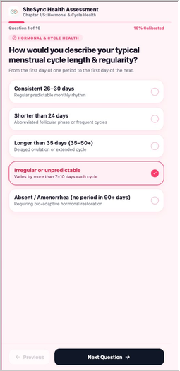
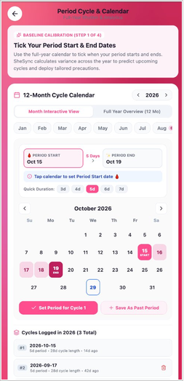
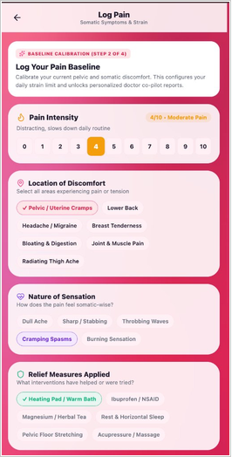
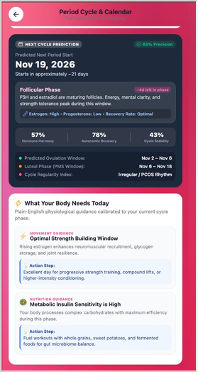
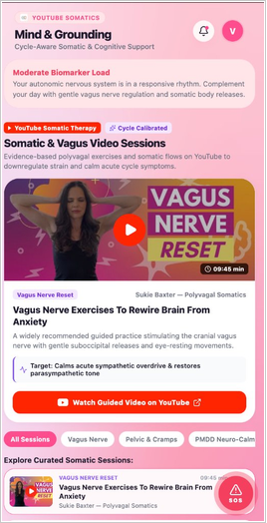
RESEARCH AND REFERENCES
MINIMUM VIABLE PRODUCT (MVP)
RESEARCH AND REFERENCES
Bharali M. et al., "Prevalence of PCOS in India: A Systematic Review & Meta-Analysis," Cureus, 2022 — pooled prevalence 11.33%.
Sharma M. et al., "PCOS among Indian adolescent girls," Nepal J. Epidemiology, 2021 — about 1 in 5.
Bull J.R. et al., "Real-world menstrual cycle characteristics of >600,000 cycles," npj Digital Medicine, 2019 — only ~13% are 28 days.
Li K. et al., "Physiological & symptomatic variation in menstrual cycles," npj Digital Medicine, 2020.
Epstein D.A. et al., "Examining Menstrual Tracking to Inform the Design of Personal Informatics Tools," ACM CHI, 2017.
Shipp L. & Blasco J., "How private is your period?" Proc. Privacy Enhancing Technologies, 2020.
GSMA, The Mobile Gender Gap Report 2025. · MeitY, Digital Personal Data Protection Rules, 2025.
Clinical intake
12-month calendar
Pain logging
MVP status
LINKS
15 working screens (Android, iOS, web)
Supabase auth & cloud sync
Cycle prediction engine
Pain, flow, mood & voice logs
Adaptive workout & somatic library
Doctor report PDF export
https://pmc.ncbi.nlm.nih.gov/articles/PMC9826643
https://pmc.ncbi.nlm.nih.gov/articles/PMC8560138
https://pmc.ncbi.nlm.nih.gov/articles/PMC6710244
https://pmc.ncbi.nlm.nih.gov/articles/PMC7250828
https://petsymposium.org/popets/2020/popets-2020-0083.pdf
https://www.gsma.com/gender-gap-2025/
https://support.google.com/googleplay/android-developer/answer/16679511
AI cycle prediction
Somatic therapy
Cover dragon silhouette adapted from game-icons.net (CC BY 3.0).
Notes:
Real screens from the working MVP, plus the studies behind the design: PCOS prevalence in India, real-world cycle variability (why fixed 28-day models fail), user-needs and privacy research.

Slide 7

MARKET OPPORTUNITY
TAM · SAM · SOM (INDIA, ANNUAL)
WHY NOW — MARKET SIGNALS
TAM · ₹17,700 Cr (~US$2.0B)
US$1.49B
US$2.07B
TAM
₹17,700 Cr
355M menstruating women in India × ₹499/yr SheSync Plus price
India FemTech market size in 2025 (IMARC)
Global menstrual-health apps market, 2025
SAM · ₹6,900 Cr (~US$0.8B)
70M / 5M
~1 in 9
SAM
₹6,900 Cr
39% of Indian women use mobile internet (GSMA) → ~138M reachable women × ₹499/yr
Flo monthly users / paying users (2024) — women pay for good cycle care
Indian women has PCOS (11.33% pooled prevalence)
SOM · ₹6.9 Cr / yr by Year 5
The gap we target
SOM
₹6.9 Cr
1% of SAM = 1.4M active users; 7% pay (~98K) + clinic & corporate B2B revenue
Indian women are coming online fast, but most trackers are built around a regular 28-day cycle and Western users — while only ~13% of real cycles are 28 days long and PCOS is common in India.
Sources: IMARC (2025) · Towards Healthcare (2025) · TechCrunch (Jul 2024) · Cureus (2022) · npj Digital Medicine (2019) · GSMA (2025)
Notes:
Bottom-up sizing. TAM: 355M menstruating women x Rs 499/yr. SAM: the ~39% of Indian women who use mobile internet. SOM: 1% of SAM in 5 years, 7% paying, plus B2B, which ties exactly to the Year-5 revenue in the financial projection. Signals: IMARC India FemTech USD 1.49B (2025); Towards Healthcare menstrual-health apps USD 2.07B (2025); Flo 70M MAU / 5M paid (TechCrunch, July 2024); Cureus 2022 meta-analysis 11.33% PCOS. USD at ~Rs 88.

Slide 8


BUSINESS MODEL & GO-TO-MARKET
BUSINESS MODEL
GO-TO-MARKET STRATEGY
FREE
SHESYNC PLUS
B2B
Phase 1 · Campus launch
Months 0–6
₹0 forever
₹49/mo · ₹499/yr
Clinics ₹999/mo
10 colleges in Delhi-NCR, starting with our own
Girls'-hostel student ambassadors
Survey-led waitlist and closed beta
10K beta users
Period & ovulation prediction
Flow, pain & mood logs
SOS & helplines
Basic cycle insights
AI cycle assistant — no long prompts
Adaptive workouts & somatic library
PCOS & PMDD programs
Doctor Co-Pilot PDF report
Clinic dashboard for patient-shared reports
Corporate wellness: employer-paid Plus
Opt-in, anonymised insights only
Phase 2 · Community & creators
Months 6–18
PCOS & period-positive creators on Instagram / YouTube
Refer a friend → 1 month of Plus free
Hindi Play Store listing & app-store SEO
250K users
Builds trust & reach
71% of Year-5 revenue
29% of Year-5 revenue
Unit economics & principles
Phase 3 · Doctors & corporates
Months 18–36
Paid conversion 3% → 7% (Flo ≈ 7%)
~82% gross margin after store & cloud fees (Y5)
Target CAC < ₹40 per active user
No ads, no selling data — women own their data
Core tracking free forever
Gynecologist & clinic partnerships
Corporate wellness pilots (B2B)
Tamil, Bengali & Marathi versions
600K+ users
Success metrics: Day-30 retention > 35% · paid conversion 3–7% · CAC < ₹40 · 20+ partner gynecologists by Month 24
Notes:
Freemium: the core tracker stays free so trust and reach grow; Plus monetises the AI and care features; B2B adds clinics and employers. GTM starts on campuses (cheap, high-trust), scales through creators and referrals, then adds doctors and corporates.

Slide 9




COMPETITIVE LANDSCAPE
HOW WE COMPARE
WHERE SHESYNC WINS
Capability | Flo | Clue | Maya | AI chatbots | SheSync
Scale today | 70M monthly users | Global, Europe-led | 6.5M+ installs (2016) | General purpose | Working MVP
Period & ovulation prediction
Irregular / PCOS-aware forecast
Adapts workouts & care to daily strain
AI answers from her own logs (no prompts)
90-day doctor-ready report
Built for India (₹49, Hindi, Indian helplines)
Privacy-first (no ad trackers)
Generic → Personal & India-first
SheSync
Maya
Flo
Clue
AI
chatbots
Tracks data → Acts on data
Irregular-first cycle engine
built for long, variable and PCOS cycles
From tracking to action
workouts, relief and mind support adapt to her body each day
core feature
partial / limited
not offered
Based on public product information, Nov 2026; re-check before final submission.
Our edge: competitors tell her when her period is due; SheSync also tells her what to do today — and hands her doctor the evidence.
Private and priced for India
no ad trackers, DPDP-ready consent, ₹49/month
Notes:
Flo: ~70M MAU and 5M paying users (TechCrunch, July 2024). Clue: European tracker. Maya (Plackal, Bengaluru): 6.5M+ installs by 2016; flagged by Mozilla Privacy Not Included and Privacy International (2019) for sharing data with Facebook. Generic AI chatbots answer questions but need long prompts and do not remember her cycle. Feature marks are our reading of public product info; verify before final submission.

Slide 10
FINANCIAL PROJECTIONS
REVENUE VS COST (₹ LAKH)
5-YEAR P&L SNAPSHOT
Metric | Year 1 | Year 2 | Year 3 | Year 4 | Year 5
Active users | 50K | 2.5 L | 6 L | 10 L | 14 L
Paying users | 1.5K | 10K | 30K | 60K | 98K
Subscription revenue | 7.5 | 49.9 | 149.7 | 299.4 | 489.0
B2B revenue | — | 10.0 | 40.0 | 100.0 | 200.0
Total revenue | 7.5 | 59.9 | 189.7 | 399.4 | 689.0
Total cost | 15.1 | 83.5 | 218.5 | 337.9 | 473.4
EBITDA | (7.6) | (23.6) | (28.8) | 61.5 | 215.7
₹ lakh unless stated; ( ) = loss. 1 crore = 100 lakh.
Key assumptions
Price ₹499/yr (or ₹49/month); paid conversion rises 3% → 7% (Flo ≈ 7%: 5M paying of 70M users)
Users: 50K → 14 lakh (1.4M) active by Year 5 = 1% of SAM, our SOM
B2B from Year 2: clinic dashboards + corporate wellness (₹10 L → ₹2 Cr)
Costs: team, marketing, cloud & AI, compliance, plus 15% Play Store fee
Year 1 runs lean on free tiers with the founding team
₹6.9 Cr
Year 4
~₹60 L
revenue in Year 5
EBITDA break-even
funding needed to break even
Notes:
All figures are projections from the stated assumptions, in Rs lakh. Revenue: 7.5, 59.9, 189.7, 399.4, 689.0. Costs: 15.1, 83.5, 218.5, 337.9, 473.4. EBITDA turns positive in Year 4; cumulative losses peak at about Rs 60 lakh at the end of Year 3, which is the funding needed to reach break-even.

